Slide 1
An illustration of Label Bias in Homelessness Data Analytics
Centering the Public Interest in Integrated Administrative Data Analytics
Module 3 of 5
Public Interest Technology University Network Year 6 Challenge
January 2026

Slide 2
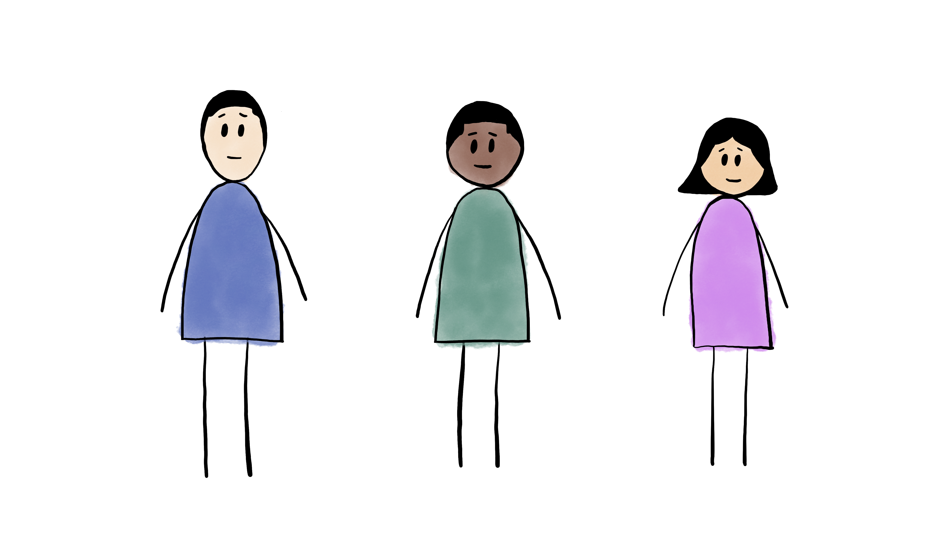
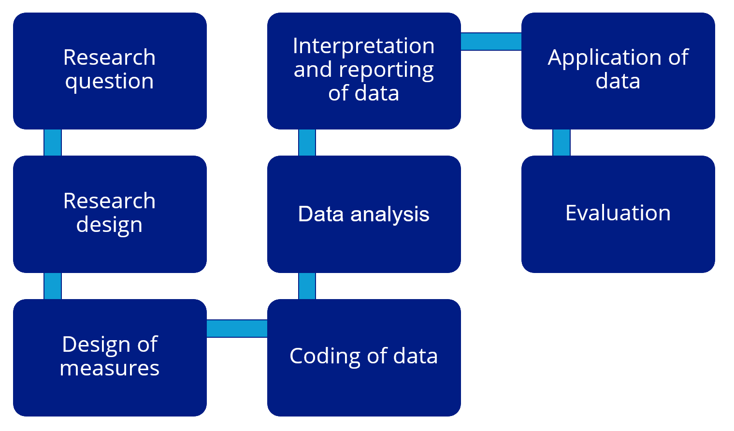


Module 3
An illustration of Label Bias in Homelessness
Data Analytics
Module 5
Recommendations to address constraints and bias in Integrated Data Analytics
2 2
Module 1
FAIR2: A framework for integrating community knowledge in data analytics and addressing discrimination bias
Module 4
An illustration of
Collider Bias in
housing research
Module 2
Demographic Data in Integrated Data Systems: Seeking Experiential Knowledge to Inform Race and Gender Data

Slide 3
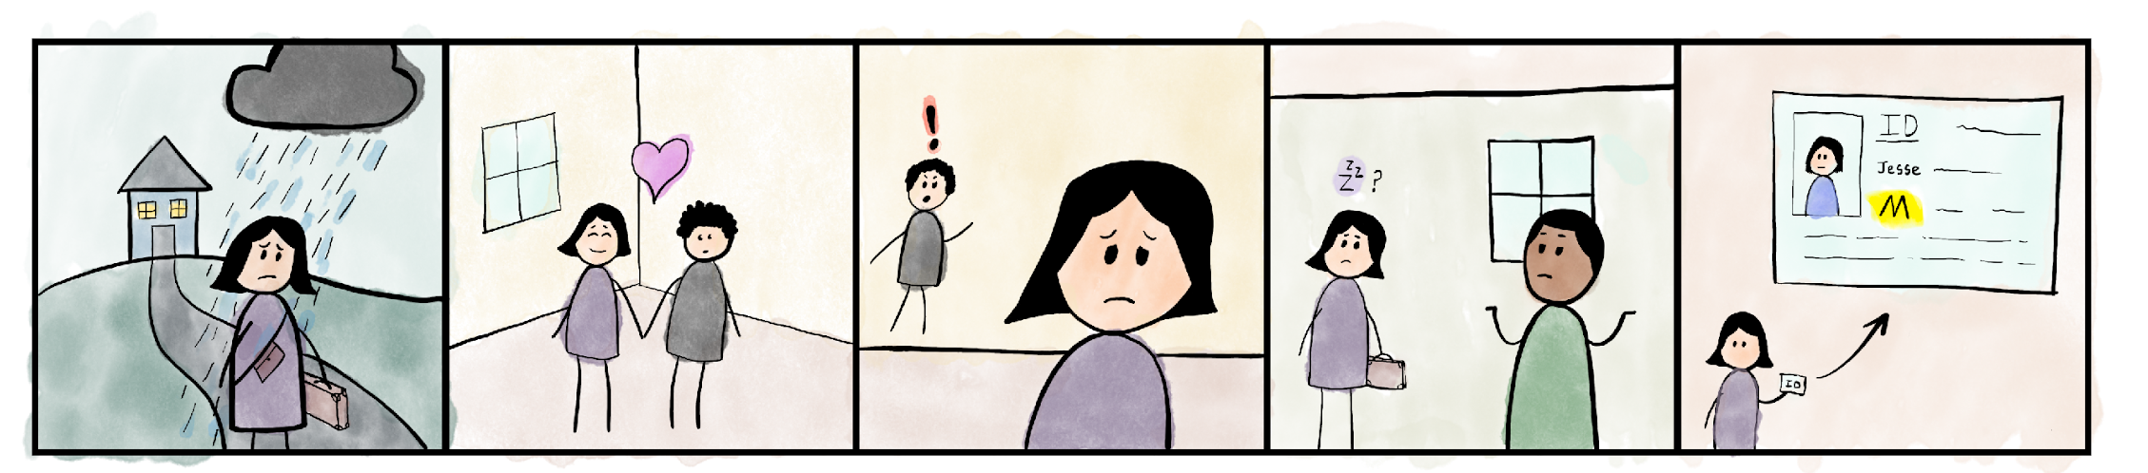
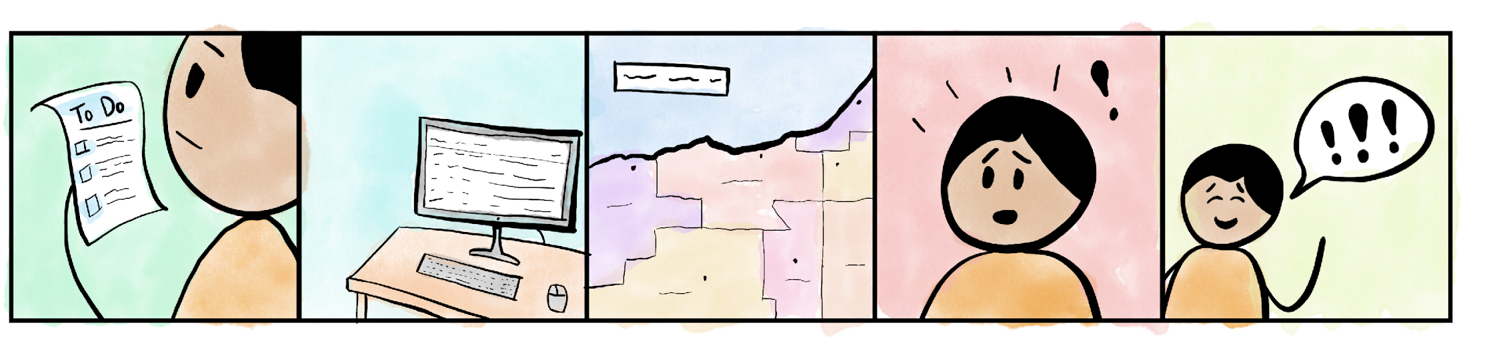
Jesse has been on her own since her parents kicked her out at 17 years old, after she came out as a trans woman.
After staying with various friends, Jesse found herself in a relationship and moved in with her partner for several months.
However, the relationship suddenly went downhill, and it was not safe for Jesse to live with her ex anymore.
Jesse is not sure where to go and is running out of friends who will let her spend a night or two on their couch.
Jesse is looking into shelters but is scared to go as a trans woman. Plus, her ID still says “Male,” and she doesn’t feel safe in a men’s shelter.
Casey is a social worker tasked with doing a needs assessment. They have a hunch that LGBTQ+ folks are in need of more services.
Casey pulls records from the biggest homeless shelter in the county for the past 5 years.
They plan to compare demographics of those serviced by the shelter to demographics in their county.
To Casey’s surprise, very few LGBTQ+ folks and nearly zero trans folks were in shelter.
Casey concluded, “Wow! The LGBTQ+ community must be so strong that they find help within their community!”

Slide 4
Jesse shows us that there are multiple reasons why someone may not seek shelter, such as safety and stigma, which are particularly salient for marginalized populations.
Think about other reasons why someone might not be able to seek shelter…
Safety
Stigma
Health issues
(Dis)ability status
Immigration status
Remember what Casey concluded when looking only at shelter use data: “Wow! The LGBTQ+ community must be so strong that they find help within their community!”
What might Casey and other community workers be missing when looking at shelter data alone?

Slide 5
Introduction
You’re a social worker who has worked with people who experienced homelessness, and oftentimes, you see people with chronic health issues and in poverty experiencing homelessness.
Your team received administrative data on people who have used shelters in your county and is asked to analyze:
What are the effects of poverty on experiences of homelessness?
What are the effects of health status on experiences of homelessness?
You know that people may experience homelessness outside of shelter for multiple reasons and you want to alert the data analyst in your team that the administrative data may systematically miss more vulnerable people…

Slide 6
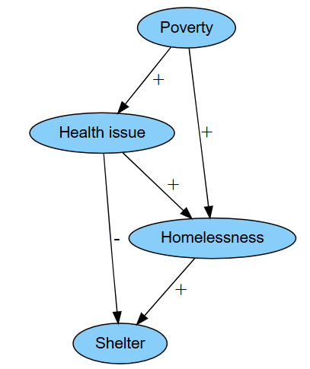
What is Label Bias
We are interested on seeing how poverty and health relate to homelessness
Homelessness is our outcome variable of interest, but our measured variable (or label) is ‘shelter use’, an imperfect proxy for homelessness
The graphic model represents the hypothesized relationships between our variables
Notes:
Label bias has to do with the outcome variable of interest, i.e. what we are trying to predict.

Slide 7
What is Label Bias
Who gets left out?
Homelessness
Shelter
Desired outcome variable
What we are actually modeling
Notes:
We are trying to predict homelessness (our outcome variable) by actually measuring shelter use. Homelessness itself is difficult to quantify, so we are choosing to quantify it by measuring those who use homeless shelters.
However, not everyone who is experiencing homelessness is able to seek shelter. So, people experiencing homelessness get left out of the shelter use data. The bias that this creates is label bias.

Slide 8
What is Label Bias
Label bias occurs when the variable used in data analytics is only a proxy label for the outcome of interest that is difficult to measure (Mhasawade et al., 2024)
Studying homelessness with data on shelter use, i.e. using shelter use as a proxy label of homelessness may lead to conclusions that:
Reproduce historical inequities and/or human biases (Banks et al., 2025)
Reflect disparities in society (Ceccon et al., 2025)
Notes:
Label bias occurs when the outcome variable is a proxy label of something that is difficult to measure.
In our example, we want to measure homelessness, but we measure homelessness by using the proxy label of shelter use.
Why is it important?
Label bias may reflect historical inequities and human biases.
Label bias may reproduce these biases. (Think about AI and machine learning.)
Label bias may reflect disparities in society.

Slide 9
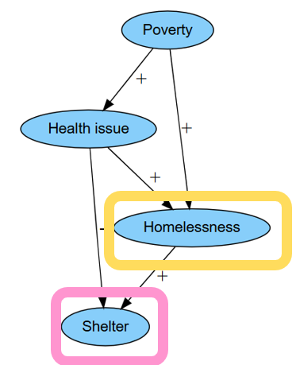
What is Label Bias
Who gets left out and why?
How does this reflect disparities/biases in society?
Desired outcome variable
What we are actually measuring
Notes:
With our example, what consequences may label bias have? Who are we leaving out of our prediction model?

Slide 10
Who is missing in the data?
“Your mental health comes first. If you’re not there, then you’re not going to actively seek help…your mental state should be taken care of because we can put people in houses or put them in shelters. But are they actively working with the psychiatrist? Are they actively working with the mental health [system]”
- Data Chat participant
The potential negative relation between health issues and shelter is consistent with experiential knowledge about most vulnerable people being reluctant or unable to access homeless services.
Notes:
Include a quote here - tired of data collection
in descriptive statistics, how do we describe these people who are less likely to show up in data ?
can give example of HUD paper (what we did to address who is missing)

Slide 11
Label Bias in Homelessness Research: Insights from Data Chat Participants
Why would someone experiencing homelessness NOT seek shelter? (and subsequently not appear in our model)
Safety, especially if LGBTQ+ options are not available
Stigma
Jesse was struggling to decide if she should seek shelter because of both her safety as a trans woman and the social stigma that oftentimes accompanies marginalized gender identities
Mental health
Connection / support /Lack of relational component, feel like “just a number”
Services may not be accessible
“The worst thing is that you share your information with somebody and instead of them helping you, they’re judging and categorizing you.” - Data Chat participant

Slide 12
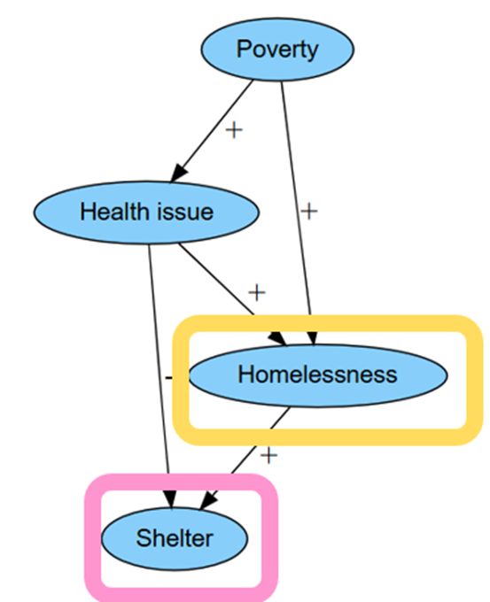
Simulated Data Example - I
To see how label bias arises in the analysis, we simulate individual-level data on people’s experience of poverty, health issues, homelessness, and shelter stay
Variable Name | Type of Variable | Meaning
Poverty | Binary | 1 = Yes, 0 = No
Health Score | Continuous | Higher Values = Worse Health Score
Homelessness | Binary | 1 = Yes, 0 = No
Shelter | Binary | 1 = Yes, 0 = No

Slide 13
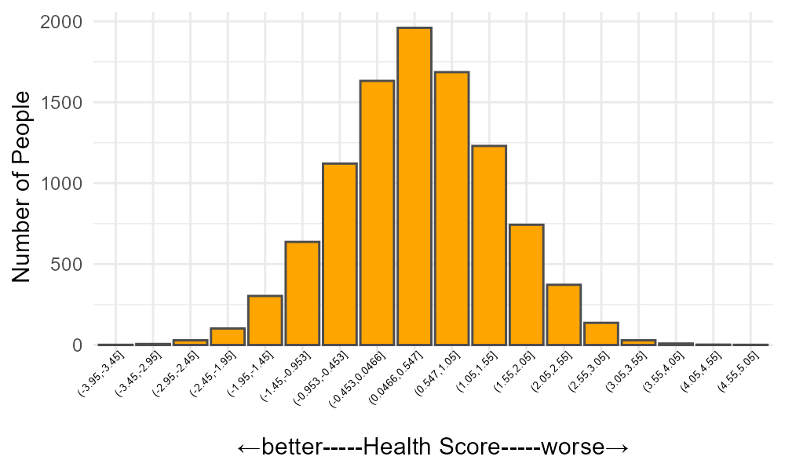
Simulated Data Example - I

Slide 14
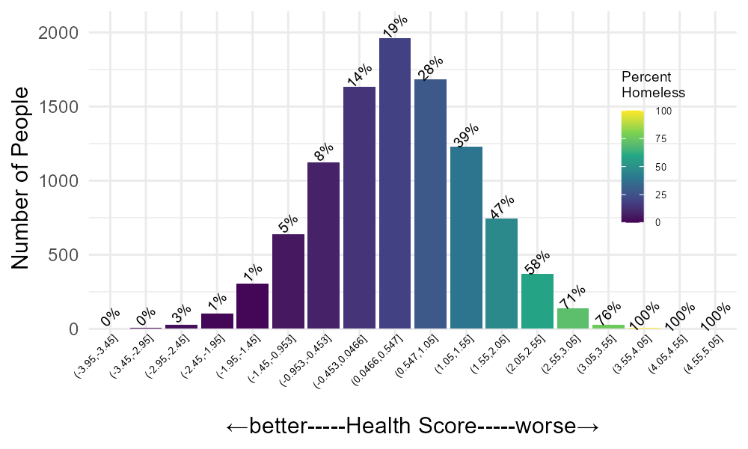

Simulated Data Example - I
Then, we estimate the effect of health issues on homelessness
Click here to see the simulation and results in R

Slide 15
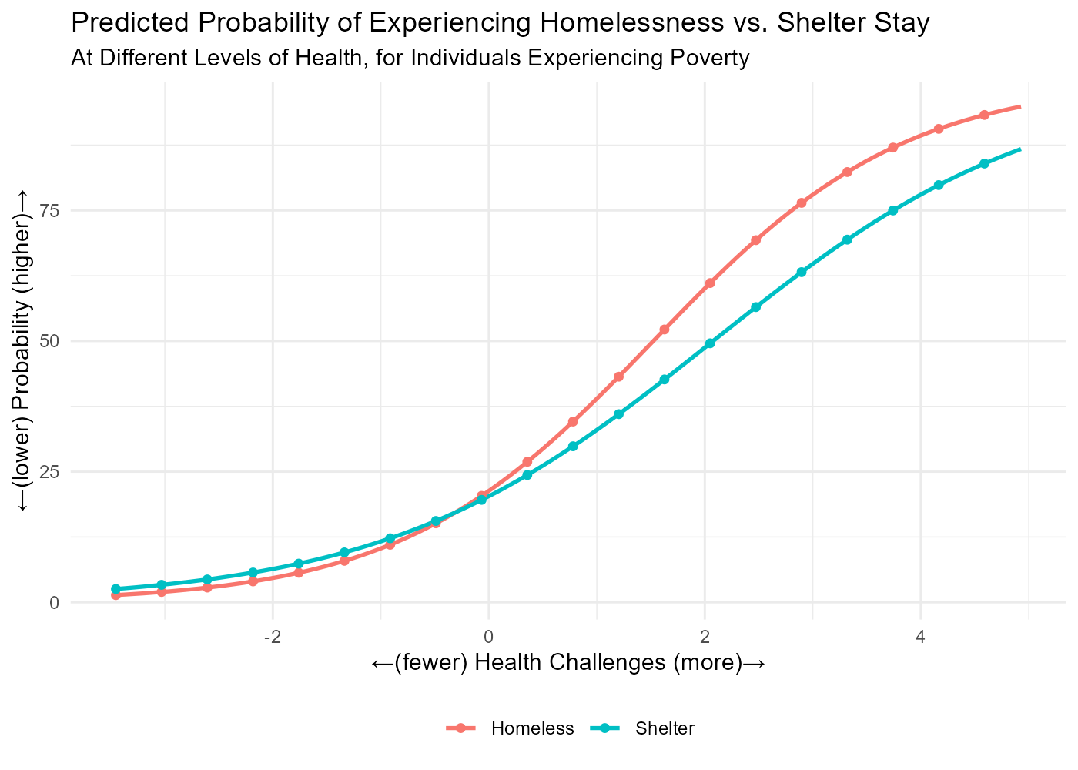
Simulated Data Example - II
With this data, we run two Logistic regression models for those in poverty:
Model 1:
Estimates the probability of Homelessness (y-axis) as a function of Health status (x-axis)
See pink estimated curve
This is the ideal model, but in reality, administrative records only include those in shelter
Model 2:
Estimates the probability of Shelter use (y-axis) as a function of Health status (x-axis)
See blue estimated curve
This is a more realistic model, but it does not capture all individuals experiencing homelessness
The simulated data example shows that using shelter data as a proxy for homelessness will underestimate the risk that health issues pose for homelessness.

Slide 16
Simulated Data Example - II
If people were prioritized for housing based on shelter data analytics, those with severe health conditions may rank lower for housing access than they would if the data captured all forms of homelessness, not just those visible through shelter use
As a result, the very individuals most vulnerable to poor outcomes could be deprioritized.

Slide 17
What to do about it?
Use your social work experience to make data analytics aware of how data is shaped by societal biases
How was the data generated? What does data intake look like?
Contextualize data with experiential knowledge of those represented in the data
Integrate health or other data (i.e. food assistance data) where hidden homelessness can be identified
Use data and models to identify who is more likely to be left out of admin data or impacted by bias
“My personal feelings on it is that the only thing that needs to be identified is ‘Yes, I’m human.’” - Data Chat participant
Notes:
Include a quote here - tired of data collection
in descriptive statistics, how do we describe these people who are less likely to show up in data ?
can give example of HUD paper (what we did to address who is missing)
“My personal feelings on it is that the only thing that needs to be identified is ‘Yes, I’m human.’”
“Maybe in the future, as youth and young adults lead more of this type of work, my hope is that it does become a lot less burdensome.”
“Being on the street, we’re not thinking about the color we are, so why is the government thinking about what color we are?”
“You’re already in survival mode to where even being at these places [service providers], you kind of just want to run.”

Slide 18

What to do about it?
Be transparent about how data is shaped by societal biases and seek experiential knowledge to inform data analytics.
Casey’s Realization:
I can’t conclude that LGBTQ+ people don’t need homeless services.
I don’t have data on all people experiencing homelessness, only on individuals who used shelters.
I need to understand the context around shelter use and who is left out of the data.

Slide 19
What to do about it?
Advocate for equitable & consistent data practices
Inclusive options (ex. SOGI question guidelines)
Accessibility
Provider training to limit implicit bias
Inform data practices with experiential knowledge (ex. SOGI questions experiential knowledge)
Advocate for safer and more supportive housing services, which will lead to a more equitable representation in administrative data, thus reduced label bias
“Being on the street, we’re not thinking about the color we are, so why is the government thinking about what color we are?” - Data Chat participant
Notes:
Include a quote here - tired of data collection
in descriptive statistics, how do we describe these people who are less likely to show up in data ?
can give example of HUD paper (what we did to address who is missing)
“My personal feelings on it is that the only thing that needs to be identified is ‘Yes, I’m human.’”
“Maybe in the future, as youth and young adults lead more of this type of work, my hope is that it does become a lot less burdensome.”
“Being on the street, we’re not thinking about the color we are, so why is the government thinking about what color we are?”
“You’re already in survival mode to where even being at these places [service providers], you kind of just want to run.”

Slide 20
References
Banks, G.C., Tonidandel, S., Dou, W. et al. (2025). How to Reduce Bias in the Life Cycle of a Data Science Project. J Bus Psychol. https://doi.org/10.1007/s10869-025-10022-x
Ceccon, M., Cornacchia, G., Pezze, D., Fabris, A., Susto, G… (2025). Underrepresentation, label bias, and proxies: Towards Data Bias Profiles for the EU AI act and beyond. Expert Systems with Applications. https://doi.org/10.1016/j.eswa.2025.128266
Mhasawade, V., D’Amour, A., & Pfohl, S. R. (2024). A Causal Perspective on Label Bias. In Proceedings of the 2024 ACM Conference on Fairness, Accountability, and Transparency (pp. 1282‑1294). ACM. https://doi.org/10.1145/3630106.3658972
Suen, L. W., Lunn, M. R., Katuzny, K., Finn, S., Duncan, L., Sevelius, J., Flentje, A., Capriotti, M. R., Lubensky, M. E., Hunt, C., Weber, S., Bibbins-Domingo, K., & Obedin-Maliver, J. (2020). What Sexual and Gender Minority People Want Researchers to Know About Sexual Orientation and Gender Identity Questions: A Qualitative Study. Archives of sexual behavior, 49(7), 2301–2318. https://doi.org/10.1007/s10508-020-01810-y
Patterson, J. G., Jabson, J. M., & Bowen, D. J. (2017). Measuring Sexual and Gender Minority Populations in Health Surveillance. LGBT health, 4(2), 82–105. https://doi.org/10.1089/lgbt.2016.0026

